Slide 1
Sunday 650
Weekly Prayer Moment
Chesterton Academy of Buffalo
Our Weekly Prayer Moment
will begin shortly.
Please keep our prayer time reflective and holy by keeping your audio on mute and your video turned off during our moment.
Thank you for joining us this week.
Notes:
Good evening !
Thank you for joining us for SUNDAY 650, the WEEKLY PRAYER MOMENT offered by Chesterton Academy of Buffalo.
We are grateful that YOU have joined us tonight to pray for our school.
Let’s begin. In the name of the Father, and of the Son, and of the Holy Spirit. Amen.

Slide 2
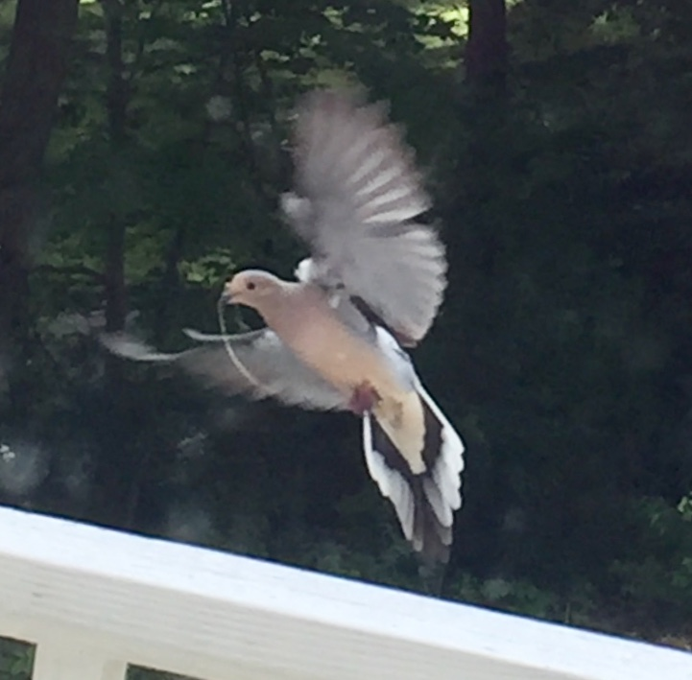
Sunday 650
Weekly Prayer Moment
Chesterton Academy of Buffalo
Come Holy Spirit!
Fill the hearts of Your faithful and enkindle in them the fire of Your love,
send forth Your Spirit and they shall be created,
and You shall renew the face of the earth.
Let us pray:
R: O God, who by the light of the Holy Spirit,
did instruct the hearts of the faithful,
grant us in the same Spirit to be truly wise and ever to rejoice in his consolation.
Through Christ our Lord. Amen
Please keep our prayer time reflective by keeping your audio on mute and video off.

Slide 3
Sunday 650
Weekly Prayer Moment
Chesterton Academy of Buffalo
Today’s Good News Reminder
Mark 1:
This is what John the Baptist proclaimed: “One mightier than I is coming after me. I am not worthy to stoop and loosen the thongs of his sandals.
I have baptized you with water; he will baptize you with the Holy Spirit.”
It happened in those days that Jesus came from Nazareth of Galilee and was baptized in the Jordan by John.
On coming up out of the water he saw the heavens being torn open and the Spirit, like a dove, descending upon him.
And a voice came from the heavens,
“You are my beloved Son; with you I am well pleased.”
Please keep our prayer time reflective by keeping your audio on mute and video off.
Notes:
“You are my beloved Son.”
In today’s gospel passage from Mark we have testimony that God proclaims Jesus as His beloved Son. What great news for those who heard it! The Son of God had become man.
Our lesson, however, starts with yesterday’s gospel. John the Baptist states that he must decrease, and Jesus must increase. Today, we hear him tell us that he is not worthy to untie Jesus’ sandal straps.
This was confusing to some of his followers, no doubt, who most likely had high expectations of John’s status and position as a prophet. Nonetheless, with Jesus’ Baptism we see this pivot take place: Jesus must increase; John must decrease.
And according to John, that pivot comes with an increase of power and grace: Jesus cleanses us with water but also unleashes the Holy Spirit to help us as His followers.
This IS the Good NEWS!
{pause}
Let us continue our PRAYER MOMENT with praise and petition.

Slide 4
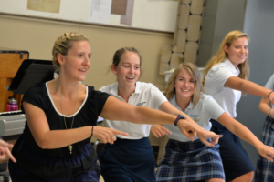
Sunday 650
Weekly Prayer Moment
Chesterton Academy of Buffalo
Heavenly Father, we thank you for
Our Chesterton school community, our administration, our teachers, and our families
R: Continue to shower Your love upon them.
Please watch over us this week, as we work to form students who are intellectually strong and who grow ever closer to You in faith.
For this we pray.
R: Lord, hear us.
Please keep our prayer time reflective by keeping your audio on mute and video off.

Slide 5
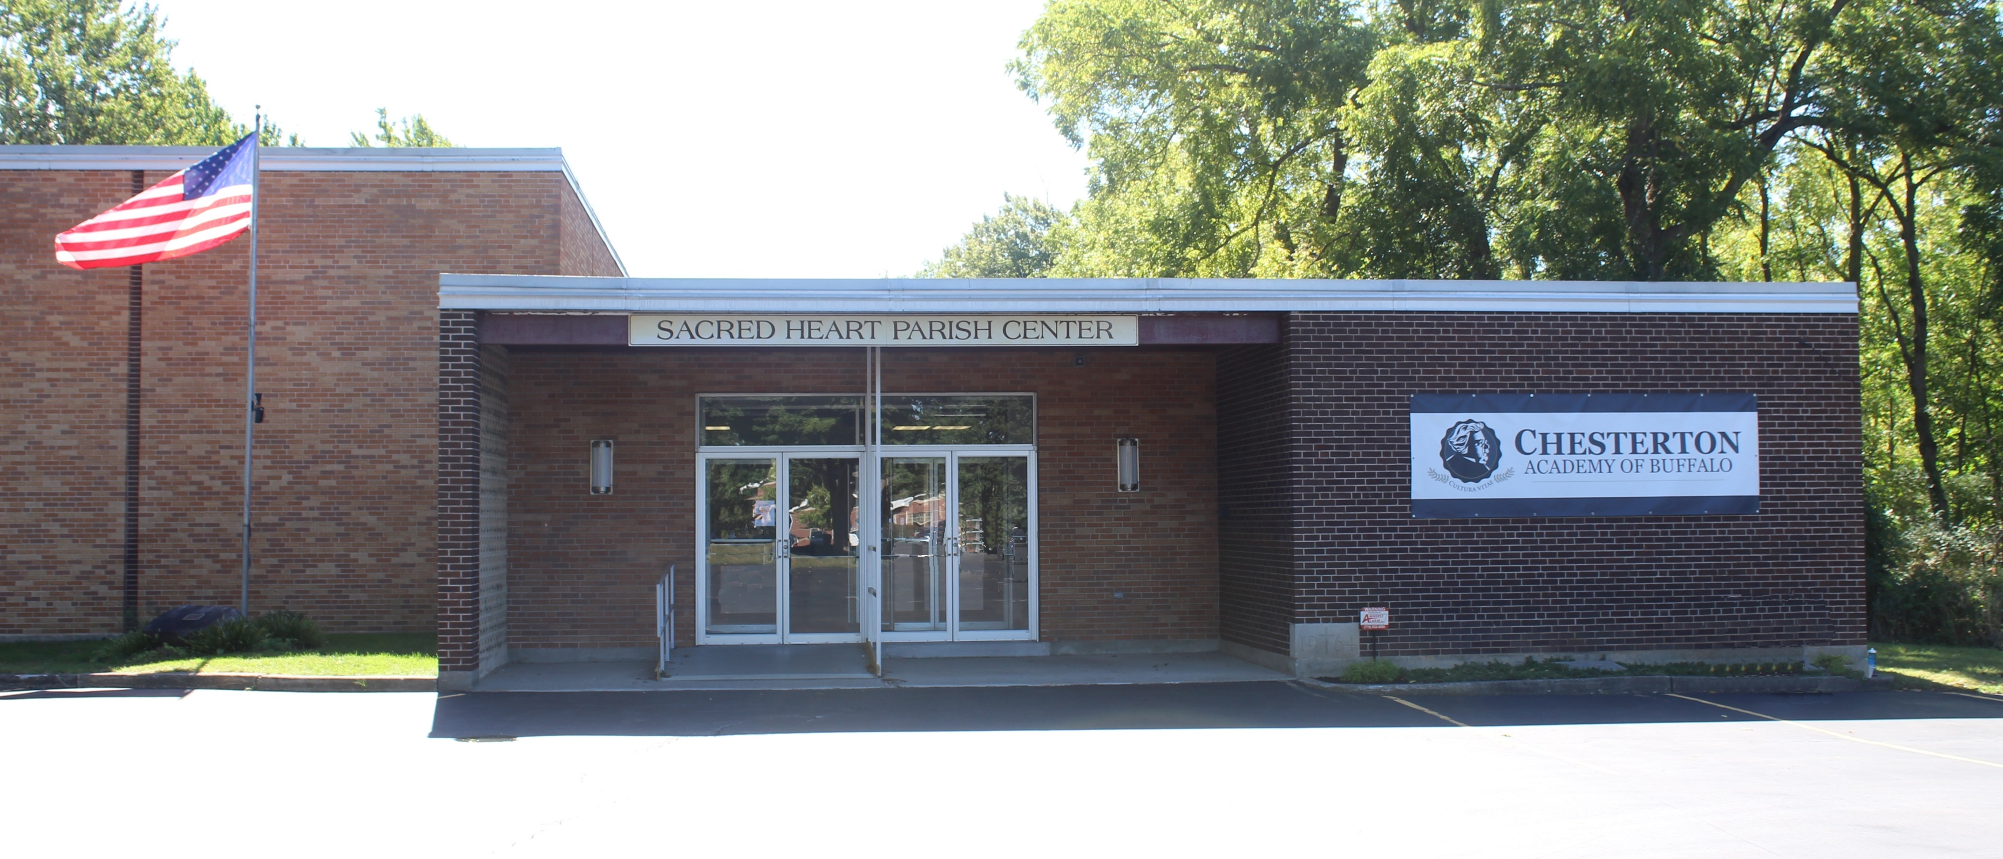
Sunday 650
Weekly Prayer Moment
Chesterton Academy of Buffalo
Heavenly Father, we thank you for
Our school’s home at Sacred Heart of Jesus parish, and for the parish’s family
R: Continue to shower Your love upon them.
Please bless all they endeavor to undertake in Your Holy Name.
For this we pray.
R: Lord, hear us.
Please keep our prayer time reflective by keeping your audio on mute and video off.

Slide 6
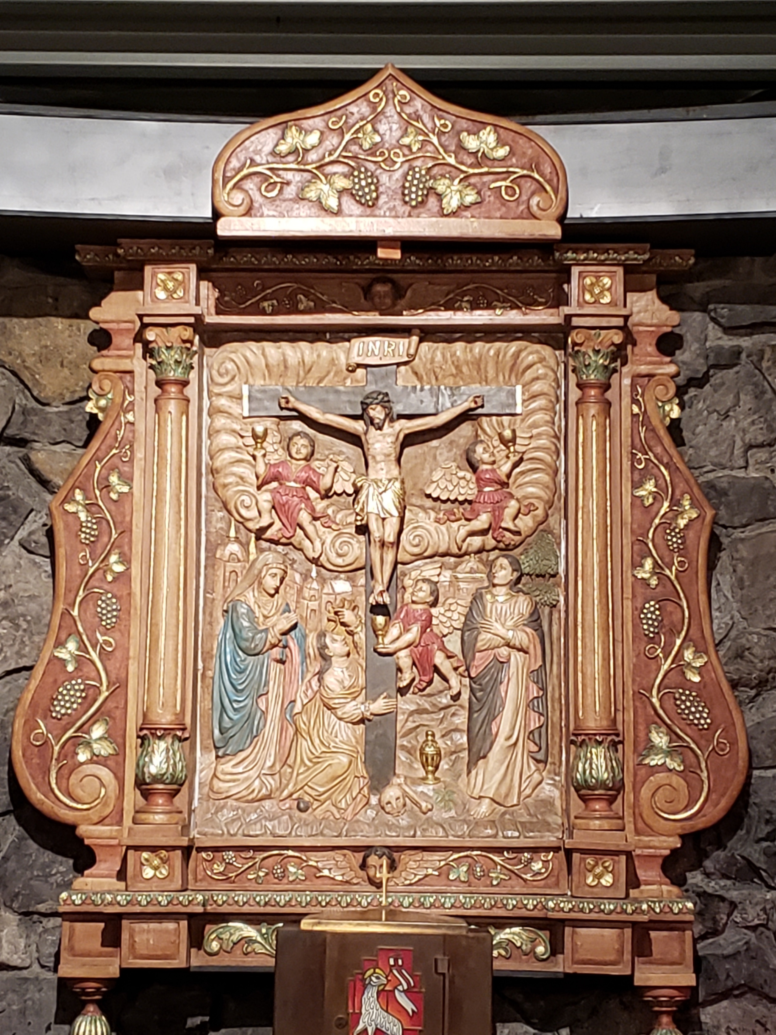
Sunday 650
Weekly Prayer Moment
Chesterton Academy of Buffalo
Heavenly Father, we thank you for
Our Faith Partners who raise up our school in their prayers to You, and for all who have requested our prayers
R: Continue to shower Your love upon them.
Please send your angels to comfort them, guide them, and inspire them. We offer you their intentions this evening. Grant their requests in accordance with Your holy will.
For this we pray.
R: Lord, hear us.
Please keep our prayer time reflective by keeping your audio on mute and video off.

Slide 7
Sunday 650
Weekly Prayer Moment
Chesterton Academy of Buffalo
Heavenly Father, we thank you for
Our benefactors, who generously give their time, talent, and treasure to our school
R: Continue to shower Your love upon them.
Please be with them in all they do and draw them ever closer to You.
For this we pray.
R: Lord, hear us.
Please keep our prayer time reflective by keeping your audio on mute and video off.

Slide 8
Sunday 650
Weekly Prayer Moment
Chesterton Academy of Buffalo
Heavenly Father, please bless us this week, as we:
Share our school with new families during our upcoming Open Houses
Prepare our students for their upcoming mid-term exams.
Prepare our 2021 fundraising efforts
Continue working on our school’s strategic planning
And for all other work being done to benefit Chesterton Academy of Buffalo
For these we pray.
R: Lord, hear us.
Please keep our prayer time reflective by keeping your audio on mute and video off.

Slide 9
Sunday 650
Weekly Prayer Moment
Chesterton Academy of Buffalo
Prayers of Praise
I will praise you, Lord, with all my heart;
I will declare all your wondrous deeds.
I will delight and rejoice in you;
I will sing hymns to your name, Most High. (Psalm 9)
Glory be to the Father,
and to the Son,
and to the Holy Spirit,
as it was in the beginning, is now, and ever shall be,
world without end.
Amen.
Please keep our prayer time reflective by keeping your audio on mute and video off.
Notes:
Please join me in praying our prayers of praise …
[RECITE PRAYERS]
Dear Jesus, thank you for bringing us together this evening for this PRAYER MOMENT. And thank you for baptizing us with water AND the Holy Spirit.
Bless and heal all who are affected by our challenging times, and send your comfort and peace to our school families.
And please be with all of us as we prepare for the challenges and the joys we will face this coming week.
We ask this In the Name of the Father, and of the Son, and of the Holy Spirit. Amen

Slide 10
Sunday 650
Weekly Prayer Moment
Chesterton Academy of Buffalo
Thank you for taking this moment to pray with us.
Please join us again next week for
Sunday 650
Chesterton Academy of Buffalo’s
Weekly Prayer Moment
If you would like to become a Faith Partner, or have an intention that we can raise up during our Weekly Prayer Moment, please email
CABprayers@gmail.com
Notes:
Thank you for joining us for Sunday650. Have a blessed week!

