Slide 1
Sunday 650
Weekly Prayer Moment
Chesterton Academy of Buffalo
Our Weekly Prayer Moment
will begin shortly.
Please keep our prayer time reflective and holy by keeping your audio on mute and your video turned off during our moment.
Thank you for joining us this week.
Notes:
Good evening !
Thank you for joining us for SUNDAY 650, the WEEKLY PRAYER MOMENT offered by Chesterton Academy of Buffalo.
We are grateful that YOU have joined us tonight to pray for our school.
Let’s begin. In the name of the Father, and of the Son, and of the Holy Spirit. Amen.

Slide 2
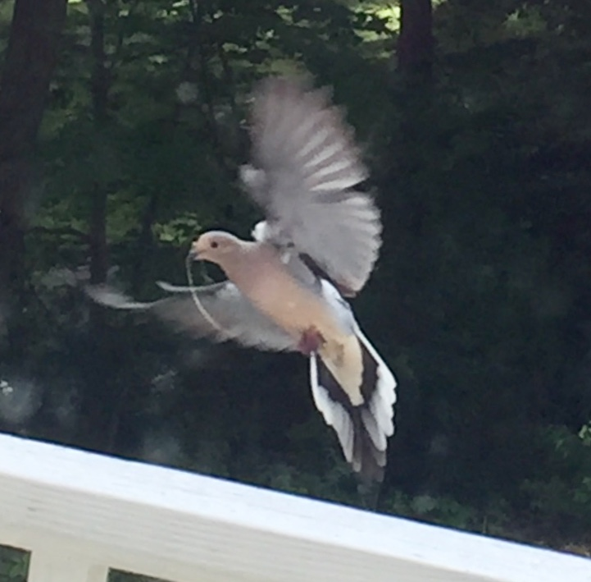
Sunday 650
Weekly Prayer Moment
Chesterton Academy of Buffalo
Come Holy Spirit!
Fill the hearts of Your faithful and enkindle in them the fire of Your love,
send forth Your Spirit and they shall be created,
and You shall renew the face of the earth.
Let us pray:
R: O God, who by the light of the Holy Spirit,
did instruct the hearts of the faithful,
grant us in the same Spirit to be truly wise and ever to rejoice in his consolation.
Through Christ our Lord. Amen
Please keep our prayer time reflective by keeping your audio on mute and video off.

Slide 3
Sunday 650
Weekly Prayer Moment
Chesterton Academy of Buffalo
Today’s Good News Reminder
Mark 4:
Jesus said to the crowds:
“To what shall we compare the kingdom of God, or what parable can we use for it?
It is like a mustard seed that, when it is sown in the ground, is the smallest of all the seeds on the earth.
But once it is sown, it springs up and becomes the largest of plants and puts forth large branches, so that the birds of the sky can dwell in its shade.”
Please keep our prayer time reflective by keeping your audio on mute and video off.
Notes:
“The Kingdom of God!”
Jesus’ teaching in our Gospel passage this week proclaims the super abundance of life in the kingdom of God.
In His parable today, He tells us about a mustard seed, making the point that even though it starts small it grows and expands. This is the way the Kingdom of God works in us. The Lord’s grace starts small in our heart and as we nurture it and allow God to work in us, it continues to grow.
We see this also in the super abundance of the Eucharistic meal. What started out as a simple supper with a few of Jesus’ friends has become a constant source of physical and spiritual nourishment for us.
Love multiplies, and the GOOD NEWS is that God’s continues to fill His kingdom with Love.
{pause}
Let us continue our PRAYER MOMENT with petitions and praise.

Slide 4
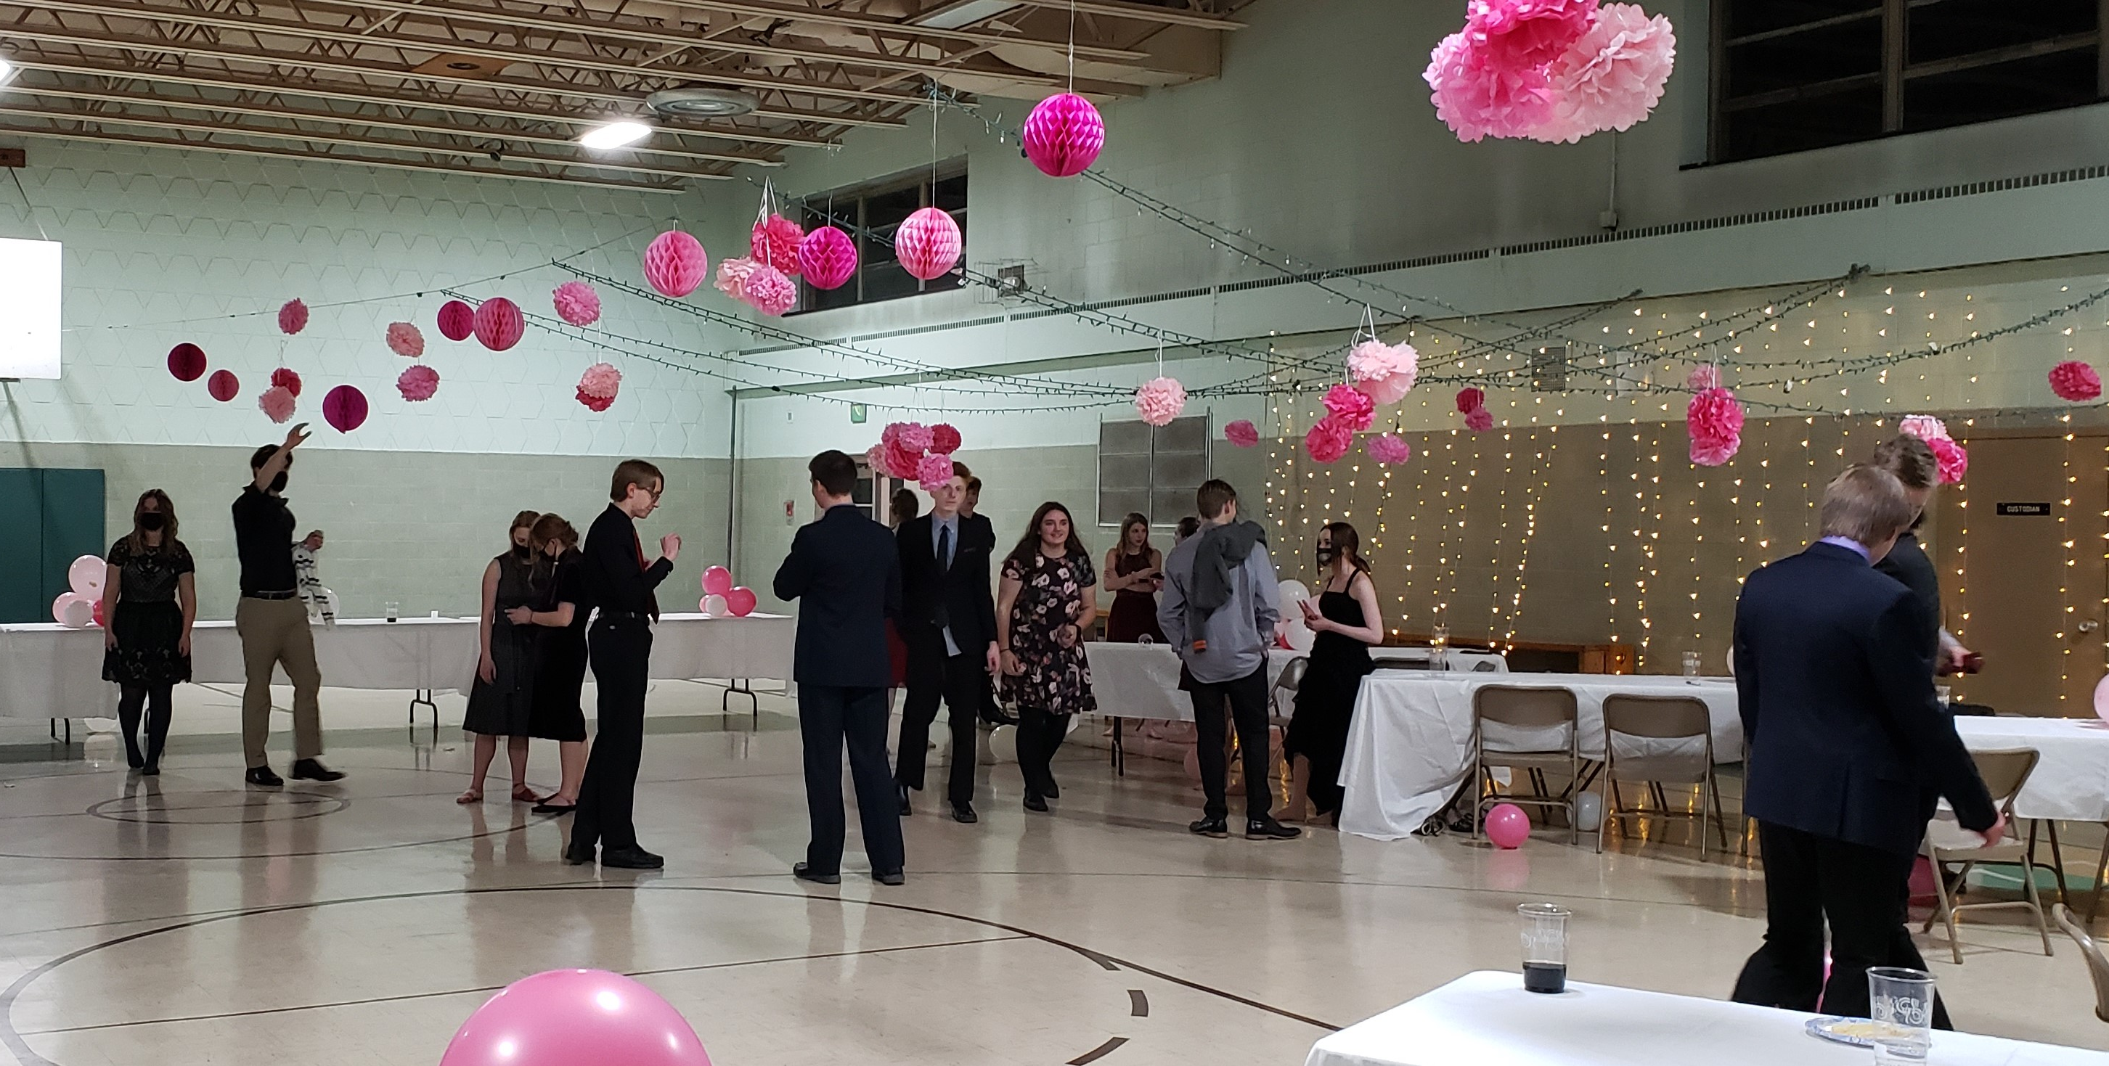
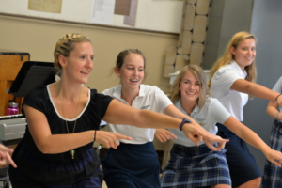
Sunday 650
Weekly Prayer Moment
Chesterton Academy of Buffalo
Heavenly Father, we thank you for
Our Chesterton school community, our administration, our teachers, and our families
R: Continue to shower Your love upon them.
Please watch over us this week, as we work to form students who are intellectually strong and who grow ever closer to You in faith.
For this we pray.
R: Lord, hear us.
Please keep our prayer time reflective by keeping your audio on mute and video off.

Slide 5
Sunday 650
Weekly Prayer Moment
Chesterton Academy of Buffalo
Heavenly Father, we thank you for
Our school’s home at Sacred Heart of Jesus parish, and for the parish’s family
R: Continue to shower Your love upon them.
Please bless all they endeavor to undertake in Your Holy Name.
For this we pray.
R: Lord, hear us.
Please keep our prayer time reflective by keeping your audio on mute and video off.

Slide 6
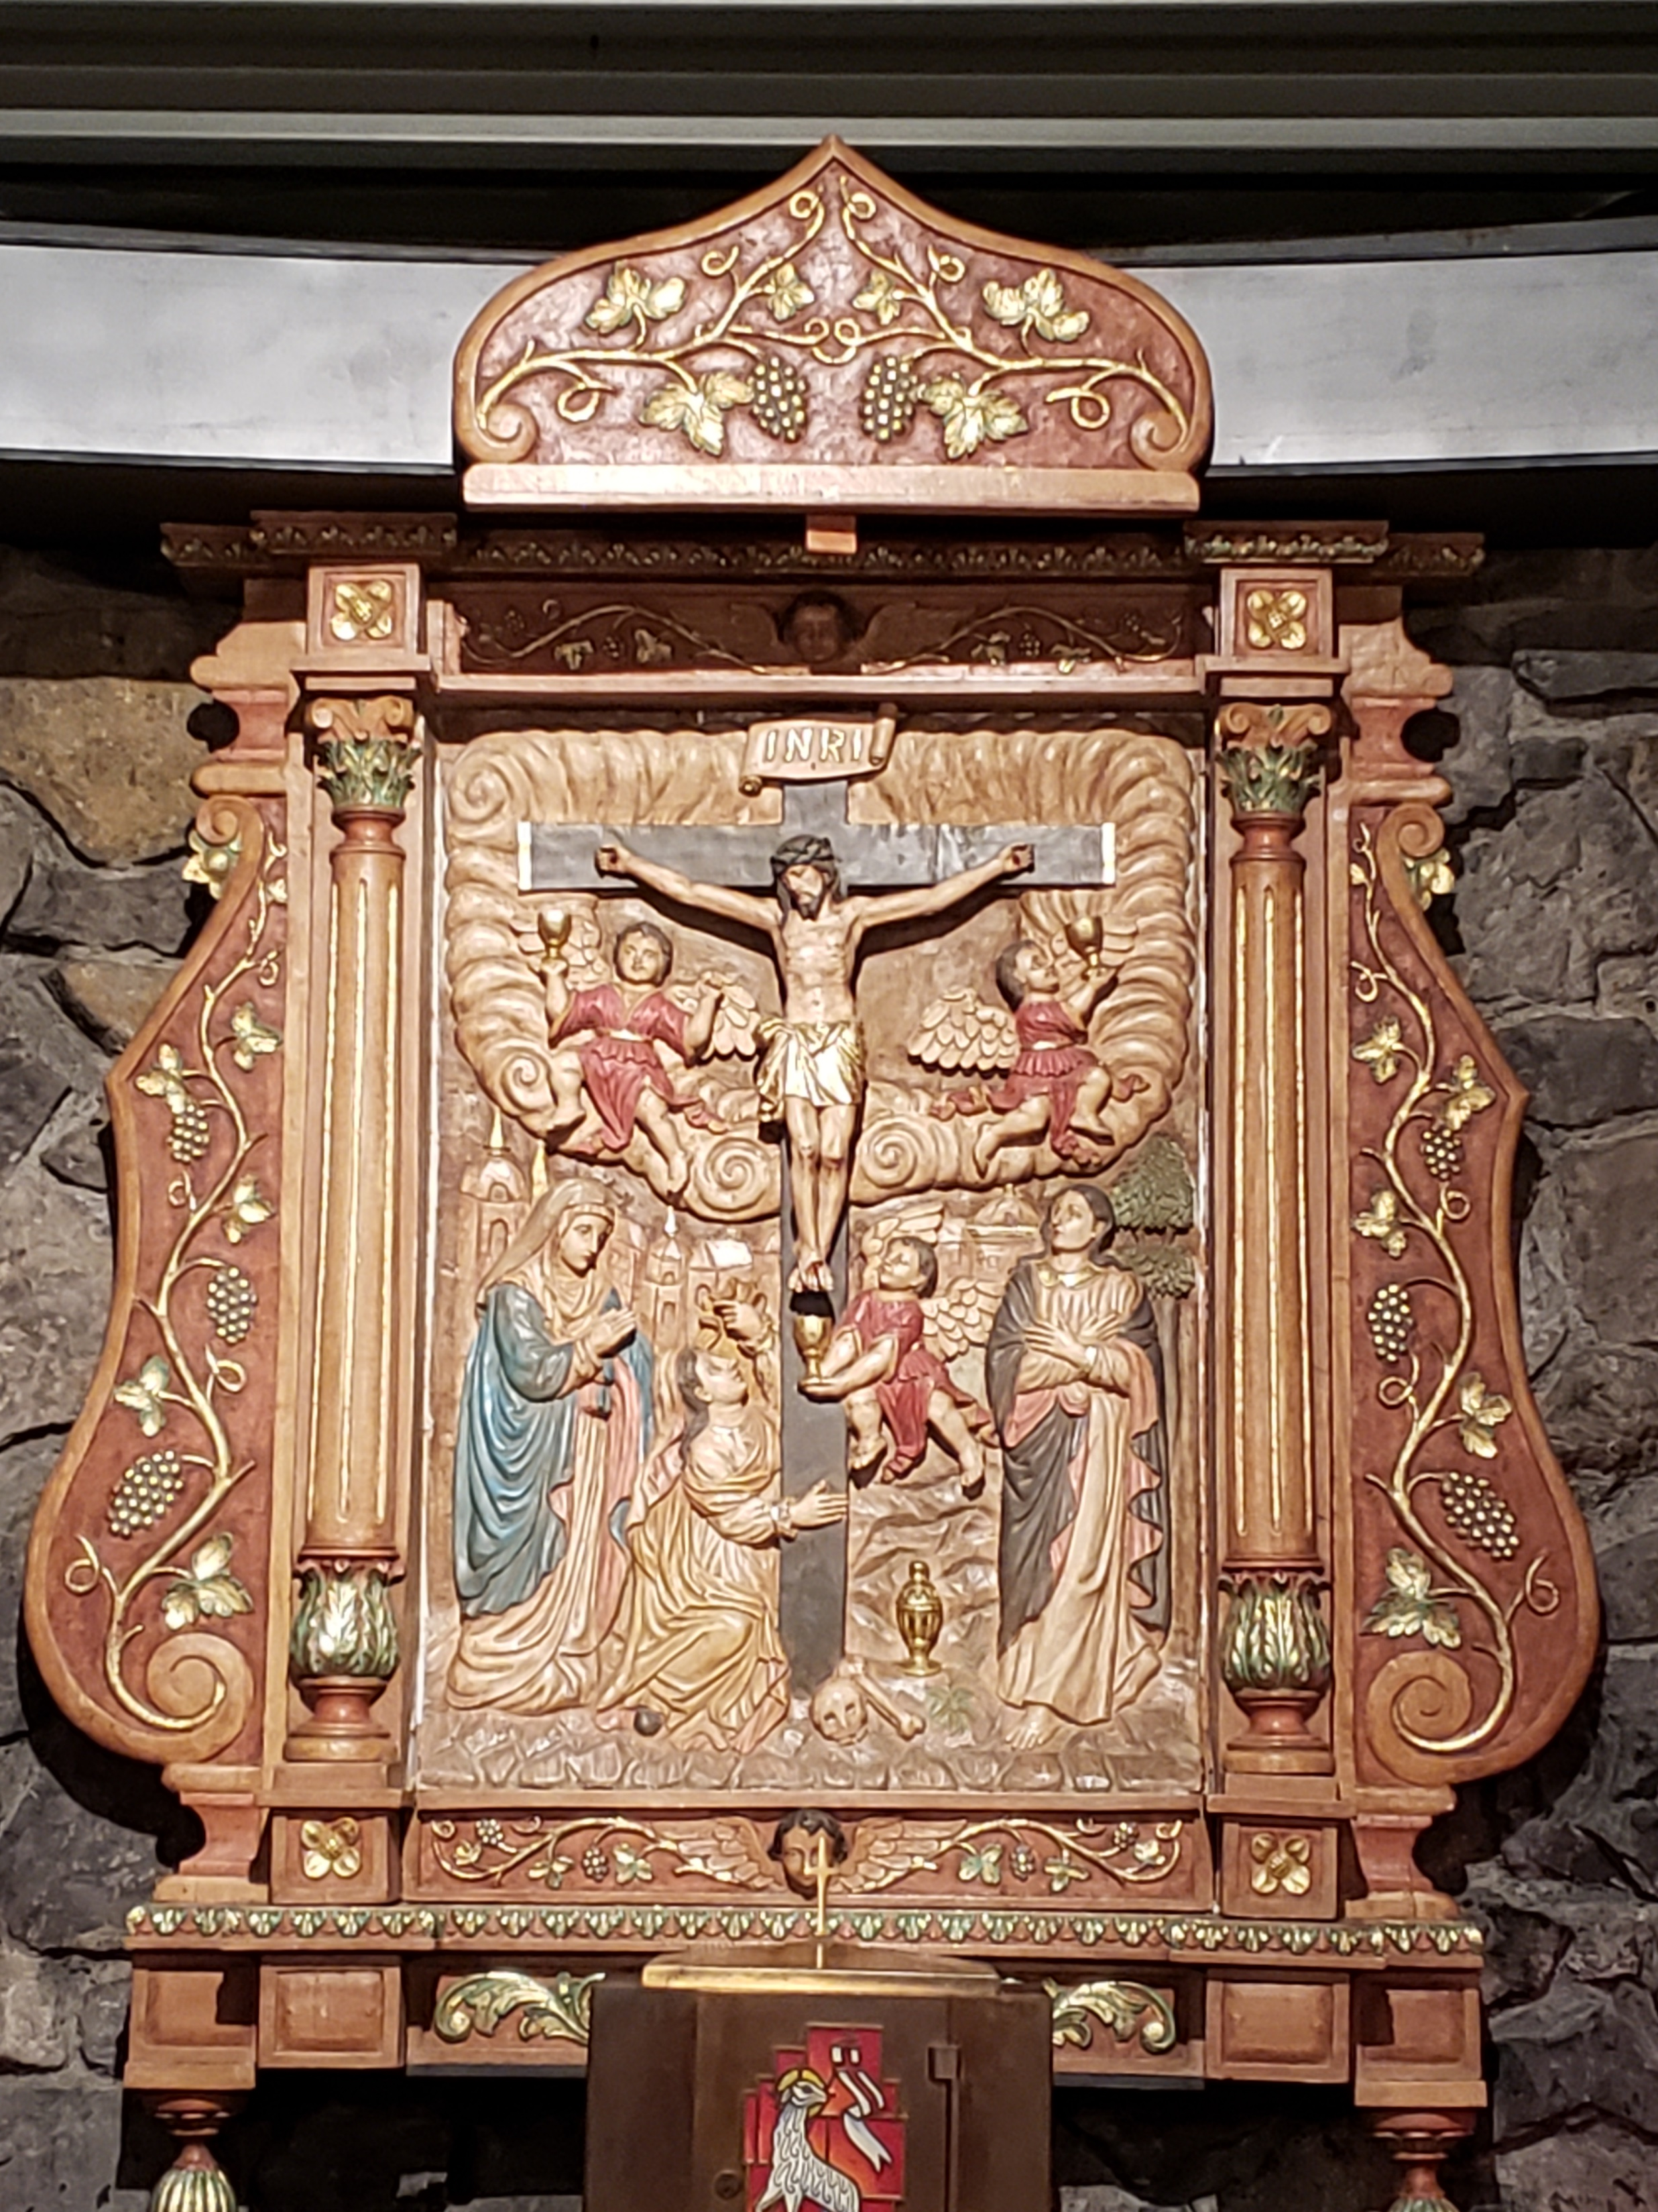
Sunday 650
Weekly Prayer Moment
Chesterton Academy of Buffalo
Heavenly Father, we thank you for
Our Faith Partners who raise up our school in their prayers to You, and for all who have requested our prayers
R: Continue to shower Your love upon them.
Please send your angels to comfort them, guide them, and inspire them. We offer you their intentions this evening. Grant their requests in accordance with Your holy will.
For this we pray.
R: Lord, hear us.
Please keep our prayer time reflective by keeping your audio on mute and video off.

Slide 7
Sunday 650
Weekly Prayer Moment
Chesterton Academy of Buffalo
Heavenly Father, we thank you for
Our benefactors, who generously give their time, talent, and treasure to our school
R: Continue to shower Your love upon them.
Please be with them in all they do and draw them ever closer to You.
For this we pray.
R: Lord, hear us.
Please keep our prayer time reflective by keeping your audio on mute and video off.

Slide 8
Sunday 650
Weekly Prayer Moment
Chesterton Academy of Buffalo
Heavenly Father, please bless our work this week.
Bless our recent graduates with the holiness and readiness they will need for the next phase of their lives.
Help our students and teachers prepare for their Final exams.
Bless our new headmaster with wisdom and strength.
Guide us in our awareness, recruitment, and fundraising efforts.
Bless all work being done to benefit Chesterton Academy of Buffalo
For these we pray.
R: Lord, hear us.
Please keep our prayer time reflective by keeping your audio on mute and video off.

Slide 9
Sunday 650
Weekly Prayer Moment
Chesterton Academy of Buffalo
Prayers of Praise
I will praise you, Lord, with all my heart;
I will declare all your wondrous deeds.
I will delight and rejoice in you;
I will sing hymns to your name, Most High. (Psalm 9)
Glory be to the Father,
and to the Son,
and to the Holy Spirit,
as it was in the beginning, is now, and ever shall be,
world without end.
Amen.
Please keep our prayer time reflective by keeping your audio on mute and video off.
Notes:
Please join me in praying our prayers of praise …
[RECITE PRAYERS]
Jesus, continue to fill us with your grace so that we can help expand Your Kingdom. Thank you for bringing us together this evening for this PRAYER MOMENT.
Bless and heal all who are affected by our challenging times, and send your comfort and peace to our school families.
And please be with all of us as we prepare for the challenges and the joys we will face this coming week.
We ask this In the Name of the Father, and of the Son, and of the Holy Spirit. Amen

Slide 10
Sunday 650
Weekly Prayer Moment
Chesterton Academy of Buffalo
Thank you for taking this moment to pray with us.
Please join us again next week for
Sunday 650
Chesterton Academy of Buffalo’s
Weekly Prayer Moment
If you would like to become a Faith Partner, or have an intention that we can raise up during our Weekly Prayer Moment, please email
CABprayers@gmail.com
Notes:
Thank you for joining us for Sunday650. Have a blessed week!

