Slide 1


Sunday 650
Weekly Prayer Moment
Chesterton Academy of Buffalo
Our Weekly Prayer Moment
will begin shortly.
Please keep our prayer time reflective and holy by keeping your audio on mute and your video turned off during our moment.
Thank you for joining us this week.
Notes:
Good evening !
Thank you for joining us for SUNDAY 650, the WEEKLY PRAYER MOMENT offered by Chesterton Academy of Buffalo.
We are grateful that YOU have joined us tonight to pray for our school.
Let’s begin. In the name of the Father, and of the Son, and of the Holy Spirit. Amen.

Slide 2
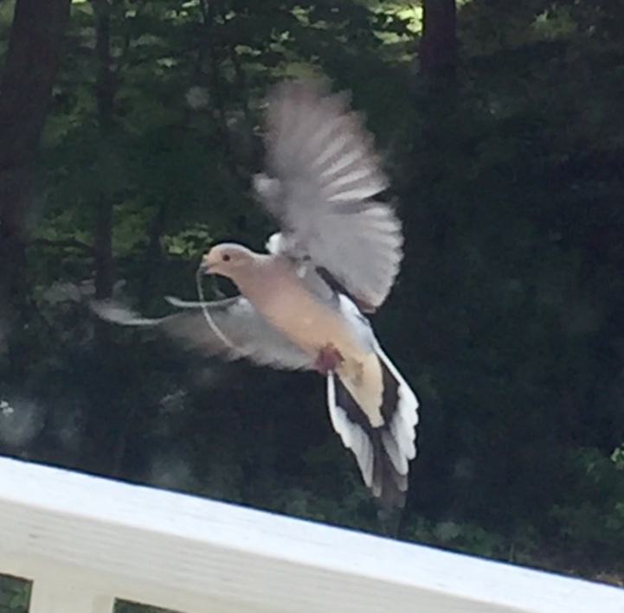
Sunday 650
Weekly Prayer Moment
Chesterton Academy of Buffalo
Come Holy Spirit!
Fill the hearts of Your faithful and enkindle in them the fire of Your love,
send forth Your Spirit and they shall be created,
and You shall renew the face of the earth.
Let us pray:
R: O God, who by the light of the Holy Spirit,
did instruct the hearts of the faithful,
grant us in the same Spirit to be truly wise and ever to rejoice in his consolation.
Through Christ our Lord. Amen
Please keep our prayer time reflective by keeping your audio on mute and video off.

Slide 3
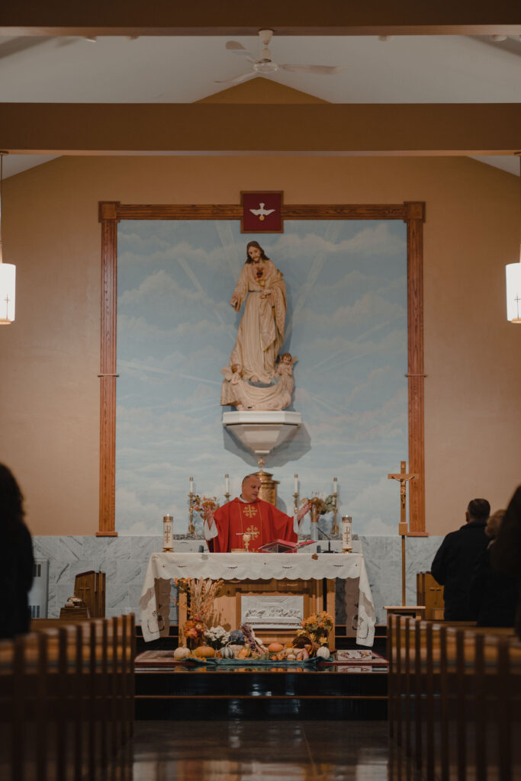
Sunday 650
Weekly Prayer Moment
Chesterton Academy of Buffalo
Today’s Good News Reminder
John 14:
“I have told you this while I am with you.
The Advocate, the Holy Spirit,
whom the Father will send in my name,
will teach you everything
and remind you of all that I told you.
Peace I leave with you; my peace I give to you.
Not as the world gives do I give it to you.
Do not let your hearts be troubled or afraid.
Please keep our prayer time reflective by keeping your audio on mute and video off.
Notes:
“The Advocate… Will Teach You!”
Today we hear Jesus promising His disciples to send the Holy Spirit to them after He ascends to heaven.
He calls the Holy Spirit The Advocate. It is an interesting title, one that would have inspired confidence in His followers. An advocate will speak on their behalf. Jesus also says He will teach them everything they need to know. In essence, Jesus has promised that the Church will not face the Accuser alone.
Our GOOD NEWS today is that the Holy Spirit is still advocating for us and teaching us what we need to know.
{pause}
Let us continue our PRAYER MOMENT with petitions and praise.

Slide 4
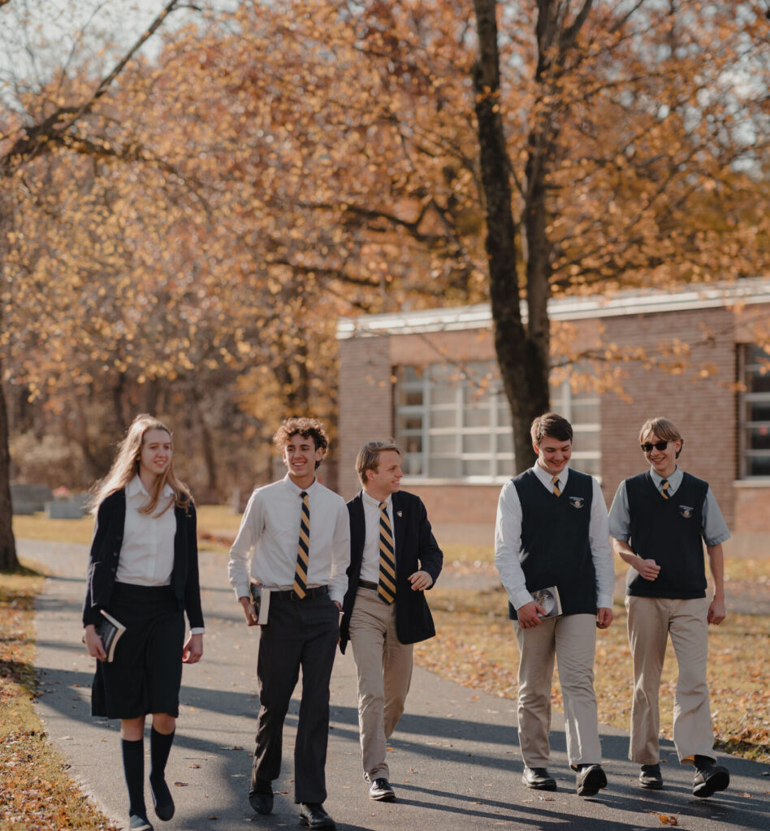
Sunday 650
Weekly Prayer Moment
Chesterton Academy of Buffalo
Heavenly Father, we thank you for
Our Chesterton school community, our administration, our teachers, and our families
R: Continue to shower Your love upon them.
Please watch over us this week, as we work to form students who are intellectually strong and who grow ever closer to You in faith.
For this we pray.
R: Lord, hear us.
Please keep our prayer time reflective by keeping your audio on mute and video off.

Slide 5

Sunday 650
Weekly Prayer Moment
Chesterton Academy of Buffalo
Heavenly Father, we thank you for
Our school’s home at Sacred Heart of Jesus parish, and for the parish’s family
R: Continue to shower Your love upon them.
Please bless all they endeavor to undertake in Your Holy Name.
For this we pray.
R: Lord, hear us.
Please keep our prayer time reflective by keeping your audio on mute and video off.

Slide 6

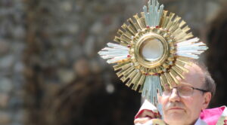
Sunday 650
Weekly Prayer Moment
Chesterton Academy of Buffalo
Heavenly Father, we thank you for
Our Faith Partners who raise up our school in their prayers to You, and for all who have requested our prayers
R: Continue to shower Your love upon them.
Please send your angels to comfort them, guide them, and inspire them. We offer you their intentions this evening. Grant their requests in accordance with Your holy will.
For this we pray.
R: Lord, hear us.
Please keep our prayer time reflective by keeping your audio on mute and video off.

Slide 7

Sunday 650
Weekly Prayer Moment
Chesterton Academy of Buffalo
Heavenly Father, we thank you for
Our benefactors, who generously give their time, talent, and treasure to our school
R: Continue to shower Your love upon them.
Please be with them in all they do and draw them ever closer to You.
For this we pray.
R: Lord, hear us.
Please keep our prayer time reflective by keeping your audio on mute and video off.

Slide 8

Sunday 650
Weekly Prayer Moment
Chesterton Academy of Buffalo
Heavenly Father, please bless our work this week.
We pray for our students, especially our seniors as they prepare for final exams and commencement.
We pray for success in our upcoming middle school retreat.
Reward our work with an increase in enrollment.
Bless all work being done to benefit Chesterton Academy.
For these we pray.
R: Lord, hear us.
Please keep our prayer time reflective by keeping your audio on mute and video off.

Slide 9
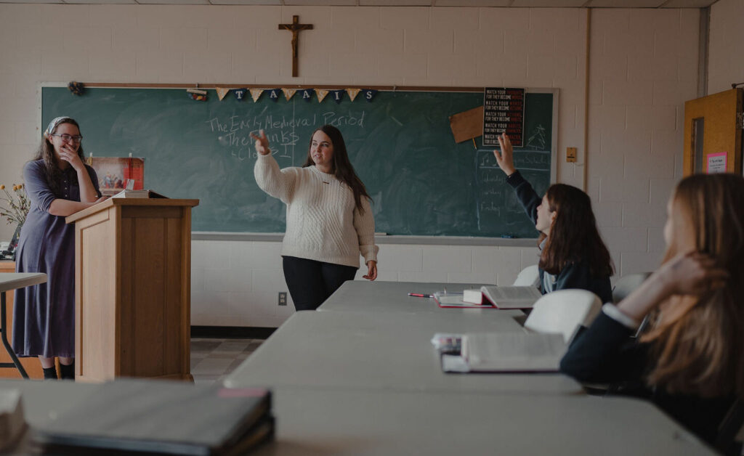
Sunday 650
Weekly Prayer Moment
Chesterton Academy of Buffalo
Prayers of Praise
I will praise you, Lord, with all my heart;
I will declare all your wondrous deeds.
I will delight and rejoice in you;
I will sing hymns to your name, Most High. (Psalm 9)
Glory be to the Father,
and to the Son,
and to the Holy Spirit,
as it was in the beginning, is now, and ever shall be,
world without end.
Amen.
Please keep our prayer time reflective by keeping your audio on mute and video off.
Notes:
Please join me in praying our prayers of praise …
[RECITE PRAYERS]
Jesus, thank you for bringing us together this evening for this PRAYER MOMENT, and for all the blessings You have given us.
Bless and heal all who are affected by our challenging times, and send your comfort and peace to our school families.
And please be with all of us as we prepare for the challenges and the joys we will face this coming week.
We ask this In the Name of the Father, and of the Son, and of the Holy Spirit. Amen

Slide 10
Sunday 650
Weekly Prayer Moment
Chesterton Academy of Buffalo
Thank you for taking this moment to pray with us.
Please join us again next week for
Sunday 650
Chesterton Academy of Buffalo’s
Weekly Prayer Moment
If you would like to become a Faith Partner, or have an intention that we can raise up during our Weekly Prayer Moment, please email
CABprayers@gmail.com
Notes:
Thank you for joining us for Sunday650.
We hope you have a blessed week.

